Slide 1
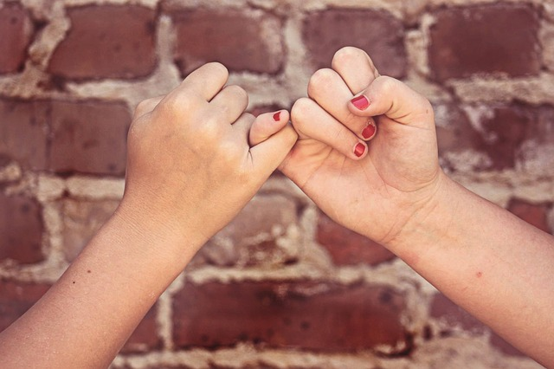
What Makes a Healthy Relationship?

Slide 2
Trust
You're talking to someone your best friend doesn’t like. Does he ignore you for the rest of the day, wondering if you’re talking about him?
Your boyfriend is laughing with another girl. Do you completely lose your cool or ignore it?
It's OK to get a bit jealous sometimes because jealousy is a natural emotion. It’s how a person acts when they’re feeling jealous that matters. You can’t have a healthy relationship if you don't trust each other.

Slide 3
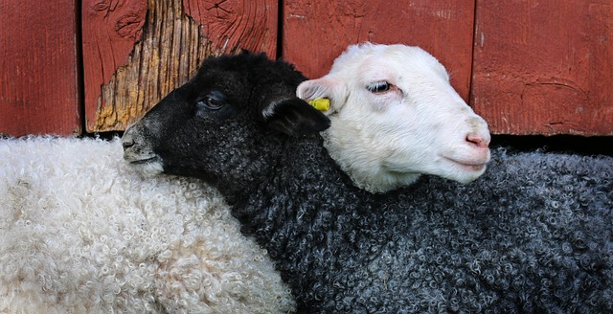
Mutual Respect
The key with mutual respect is that your friend is into you for who you are e.g. for your great sense of humour, your love of soaps etc.
Does your friend listen when you say you're not comfortable doing something and then back off right away?
Respect in a relationship means that both people value who the other person is and understand without challenging the other person's boundaries.

Slide 4
Honesty
This one goes hand-in-hand with trust because it's tough to trust someone when one of you isn't being honest.
Have you ever caught your friend out? For example, they told you that they had to go to their dad’s on Friday night but it turned out they were at the cinema with some other friends?
The next time they say they’re at their dad’s, you'll have a lot more trouble believing them!

Slide 5
Support
It's not just in bad times that your friend should support you.
Some people are great in a crisis when your whole world is falling apart but they don’t like it when things are going right for you (or vice versa).
In a healthy relationship, the other person is there for you with a shoulder to cry on, both when you find out your parents are getting divorced and to celebrate with you when you get the lead part in the school play.

Slide 6
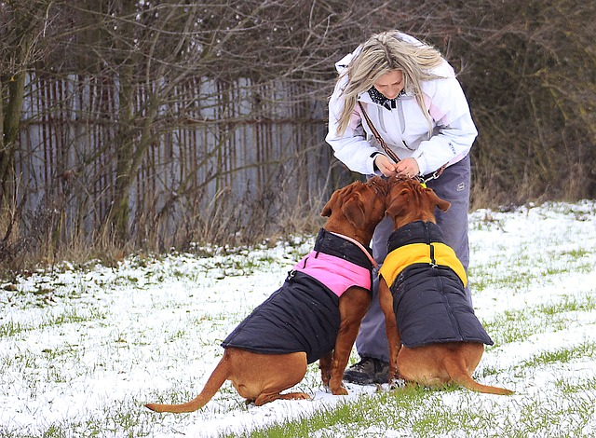
Fairness
Do you take turns choosing which game to play on the XBox?
Do you watch films that you both want to see?
Give and take is necessary in healthy relationships.
If a relationship turns into a power struggle, with one person fighting to get his or her way all the time, then pretty soon it’ll all fall apart.

Slide 7
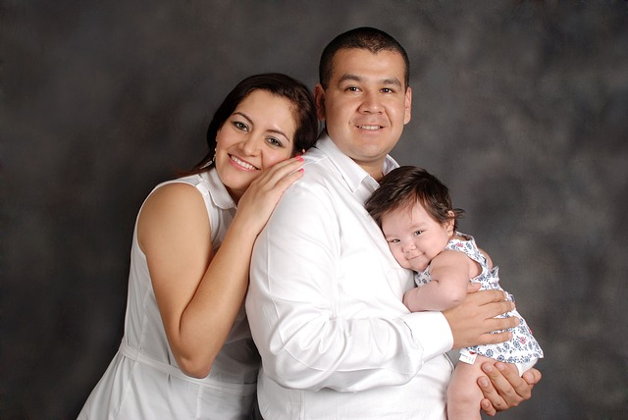
Your Own Identity
In a healthy relationship, you should be able to be yourself.
You both have your own lives (families, friends, interests, hobbies, etc.) and that shouldn't change. Neither of you should have to pretend to like something you don't, or give up seeing other friends, or drop out of activities you love.
You should also feel free to develop new hobbies or interests and make new friends. Give and take is necessary in healthy relationships.

Slide 8
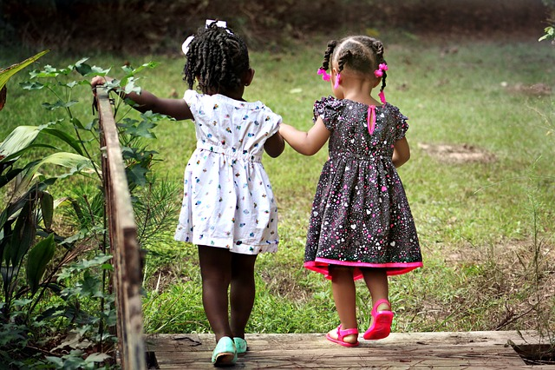
Communication
“I’m fine!” We’ve all heard that phrase so many times when clearly the person we are asking isn’t fine at all!
Miscommunication is the main reason that relationships break down so it is very important to be able to talk about things in a sensible way.
Never keep a feeling bottled up because you're afraid it's not what your friend wants to hear or because you worry about sounding silly.
In a healthy relationship, the other person will give you some time and space to think something through before you're ready to talk about it.

