Slide 1
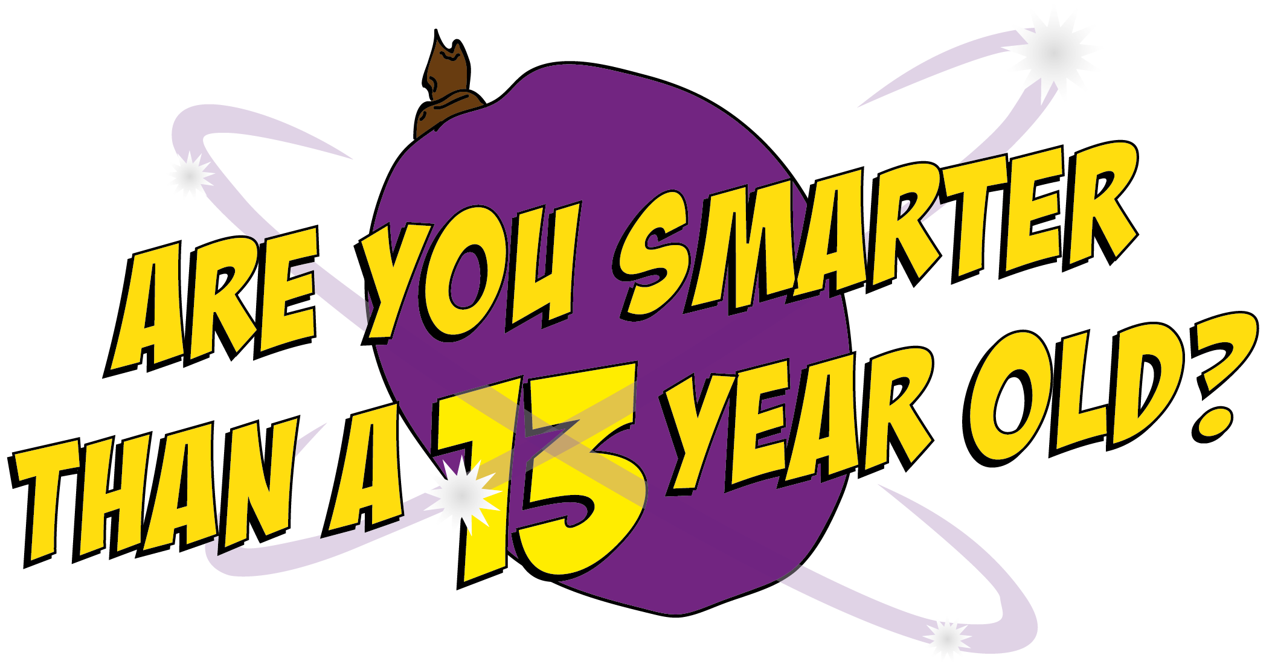

Slide 2
Question 1

Slide 3
What causes the changes that happen in the body during puberty?
A. Your height
C. Your hormones
D. Your chocolate intake
B. Your age

Slide 4
What causes the changes that happen in the body during puberty?
A. Your height
C. Your hormones
D. Your chocolate intake
B. Your age

Slide 5
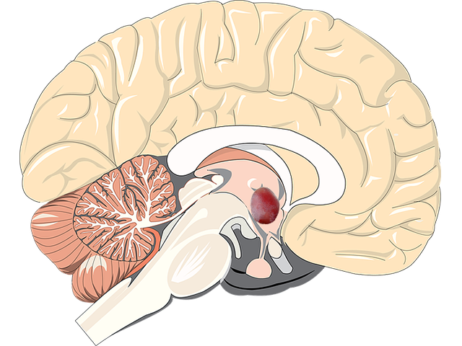
Trigger Hormones
All the changes that happen during puberty are caused by hormones. A part of your brain, about the size of a grape, called the hypothalmus, is responsible for producing the hormone that triggers puberty and the production of more new hormones, which are responsible for the main physical changes to your body.
Hypothalmus

Slide 6
Question 2

Slide 7
Testosterone is the main male hormone produced in the…
A. Testicles
C. Kidneys
B. Stomach
D. Brain

Slide 8
Testosterone is the main male hormone produced in the…
A. Testicles
C. Kidneys
B. Stomach
D. Brain

Slide 9
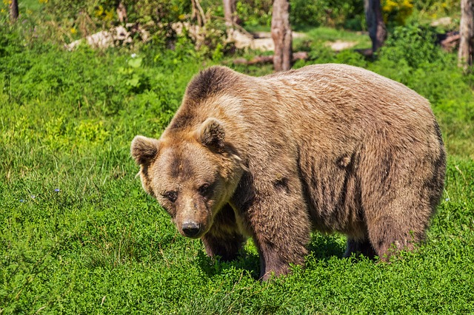
Trigger Hormones
The main sex hormone in boys is called testosterone and is produced in the testicles. Testosterone makes your voice go deep, your muscles grow, kick starts your interest in the opposite sex and makes your body and facial hair sprout. Hair can grow virtually anywhere on your body so don’t be alarmed - you’re not really turning into a bear! Testosterone also causes your testicles to produce sperm.

Slide 10
Question 3

Slide 11
Which of these is the proper word for sperm?
A. Semen
C. Jizz
B. Spunk
D. Ejaculation

Slide 12
Which of these is not another word for sperm?
A. Semen
C. Jizz
B. Spunk
D. Ejaculation

Slide 13
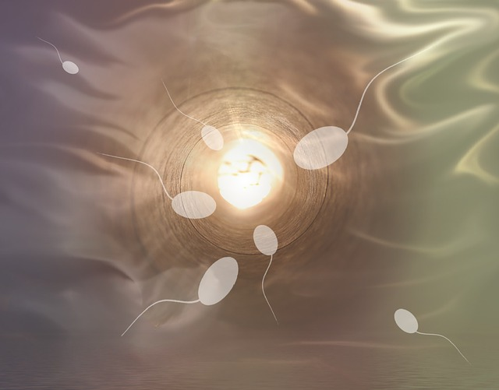
Sperm Count
Semen is the word for the gloopy liquid made up of sperm. Part of puberty is when your testicles start producing semen. When semen comes out of your penis it is known as ejaculation.

Slide 14
Question 4

Slide 15
Which of these is not a name for male genitals?
A. Willy
C. Penis
B. Knob
D. Gear

Slide 16
Which of these is not a name for male genitals?
A. Willy
C. Penis
B. Knob
D. Gear

Slide 17
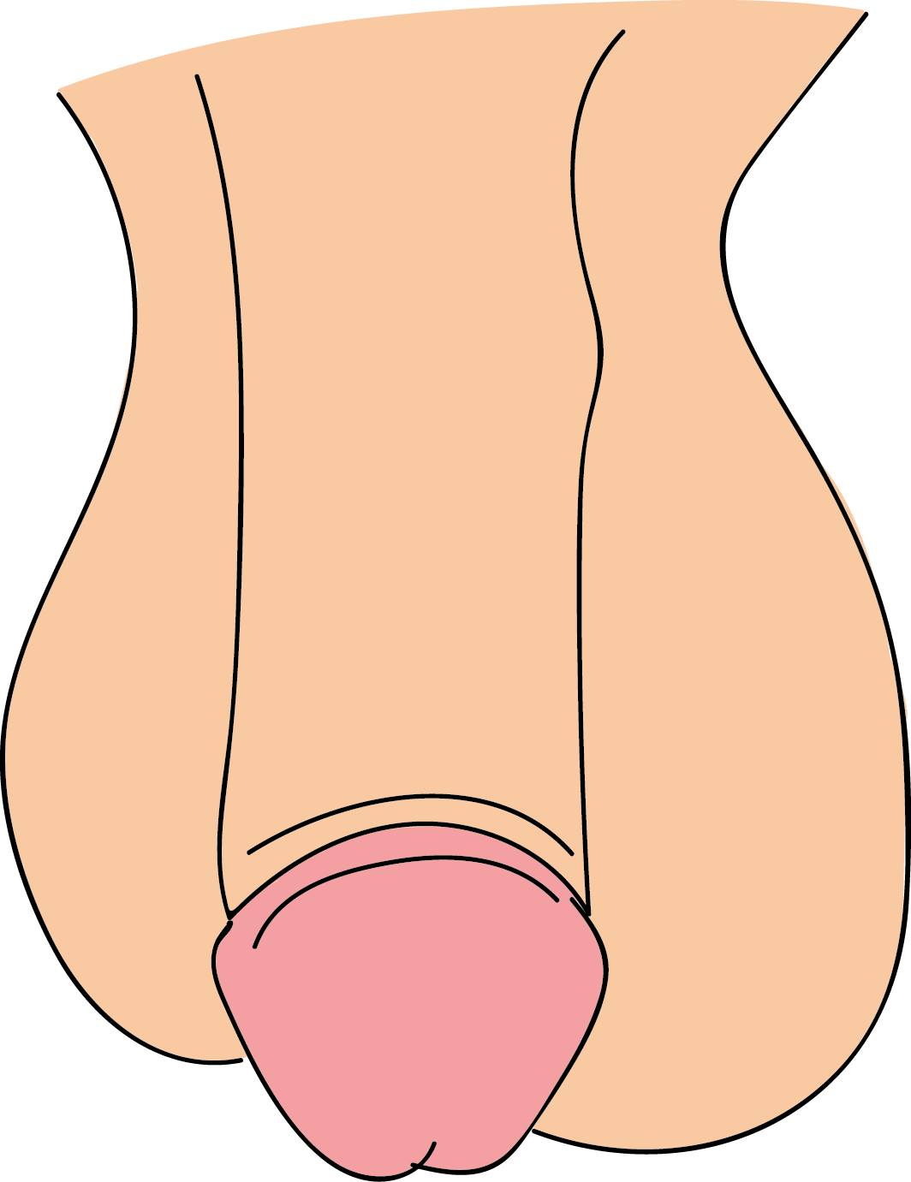
All Shapes and Sizes
Most people have their own names for their penis and there are literally dozens of slang words that are used. The penis can be flaccid (floppy) or erect (stiff and hard). Penises come in all different shapes and sizes. If there’s one part of the body you will worry about during puberty, it will be your penis. A number of new things start happening, including overall growth, erections and sprouting hair down there. An erection is when your penis becomes hard and stands up straight.

Slide 18
All Shapes and Sizes
Erections happen when nerve signals cause extra blood to flow into the penis. That’s what makes it hard. One of the most common worries of boys and men is related to the size of their penis. Just so you know, the average erect penis is between 12.5 and 15cm long. Boys often worry that other people will only want to date them if they have a large penis. The reality is that most people just want to find someone who is interesting, kind and funny! Your penis has two main jobs:- to get rid of waste water (urine) and to eject semen.

Slide 19
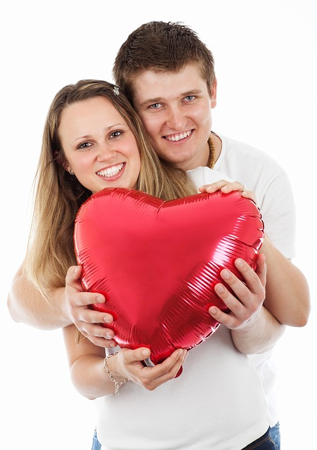
Let’s Talk About Sex!
Puberty for a girl is quite similar to a boy, except their breasts become bigger, they start their periods and their sex organs develop. Breasts make a girl look grown-up and attractive and they make milk for their babes, too. Periods involve women releasing an egg every month from their ovaries, where all the eggs are stored, and it travelling down the fallopian tube where it sits for a few days before being released, along with the uterus lining which has also thickened at the same time.

Slide 20
Let’s Talk About Sex!
This causes dark blood to trickle from the woman’s vagina and is known technically as menstruation. You start to become a sexual person when you go through puberty. This doesn’t mean you are ready to have sex just because you can, though! People have sex or ‘make love’ because they feel deeply attracted to or are in love with someone. People can be sexual with each other in lots of ways. When a man and a woman have sex, it means the man’s erect penis goes inside the woman’s vagina and he ejaculates.

Slide 21
Question 5

Slide 22
A woman shouldn’t get pregnant if…
A. She is having her period
C. Contraception is used
D. It’s her first time having sex
B. She is told it s ok

Slide 23
A woman shouldn’t get pregnant if…
A. She is having her period
C. Contraception is used
D. It’s her first time having sex
B. She doesn’t orgasm

Slide 24
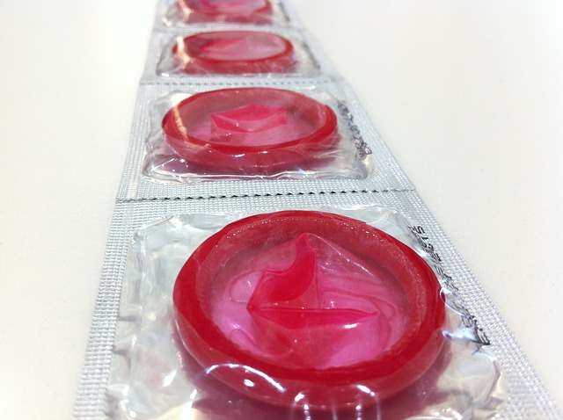
Making Babies
Babies are made when a single sperm from a man joins together with a woman’s egg, which can happen after sex, unless the man is wearing a condom. Wearing a condom is a form of contraception. Contraception allows a man and a woman to prevent pregnancy when they have sex. Condoms also prevent the spread of infections known as STIs (sexually transmitted infections). If you really love someone and want to have sex with them, you should be willing to wear a condom.

Slide 25
Lesson 2

Slide 26
What is homophobia?
C. Hate and abuse towards gay people
A. A fear of sex
D. Hate and abuse towards old people
B. A fear of spiders

Slide 27
What is homophobia?
C. Hate and abuse towards gay people
A. A fear of sex
D. Hate and abuse towards old people
B. A fear of spiders

Slide 28
Bullying Behaviour
Homophobia causes a lot of misery and suffering. Homophobic behaviour includes teasing, name-calling, pushing, hitting and tormenting someone simply because of their sexual orientation. “That’s so gay!” might seem like a harmless thing to say but it reinforces the idea that it is fine to disrespect others and not care
for everyone.

