Slide 1
Times Table Awards
A New Way

Slide 2
Bronze Award
Maths Bronze Award
x2, x10, x5
St Stephens CE

Slide 3
What’s Inside?
You must get all the questions correct in 3 and a half minutes. You must do this 3 times to achieve the award

Slide 4
Silver Award
Maths Silver Award
x3, x4, x8
St Stephens CE

Slide 5
What’s Inside?
You must get all the questions correct in a good time
You must do this 3 times to achieve the award

Slide 6
Gold Award
Maths Gold Award
All up to 12x12
St Stephens CE

Slide 7
What’s Inside?
You must get all the questions correct in 3 and a half minutes. You must do this 3 times to achieve the award

Slide 8
Powerhouse Award

Slide 9
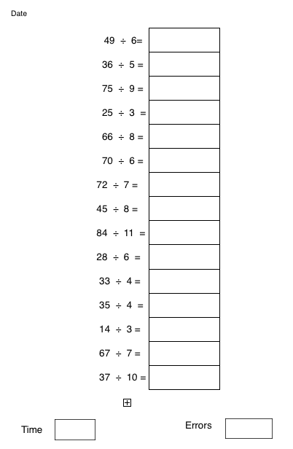
What’s Inside?
You must get all the questions correct in 3 and a half minutes. You must do this 3 times to achieve the award

Slide 10
Gladiator Award

Slide 11
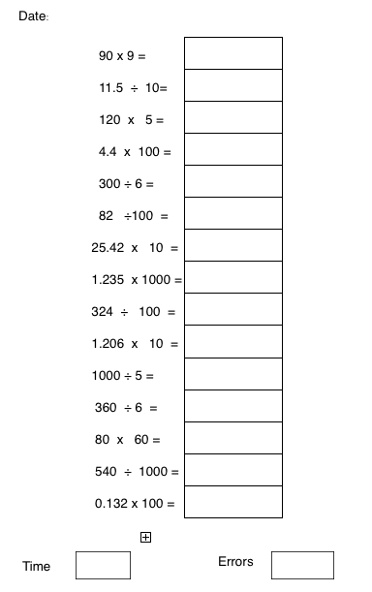
What’s Inside?
You must get all the questions correct in 3 and a half minutes.
You must do this 3 times to achieve the award

Slide 12
Decimator Award

Slide 13
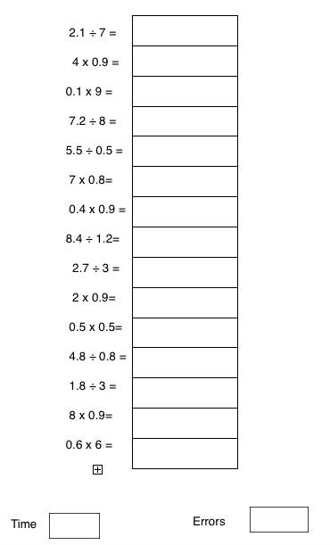
What’s Inside?
You must get all the questions correct in 3 and a half minutes. You must do this 3 times to achieve the award

