Slide 1
PSHE and Citizenship
Growing Up | Our Bodies
PSHE and Citizenship | KS1 | Health and Wellbeing | Growing Up | Our Bodies | Lesson 1

Slide 3
Aim
I can name the main parts of boys’ and girls’ bodies.
Success Criteria
I can use the scientific names for parts of the body.
I can name the differences between girls’ and boys’ bodies.
This resource is fully in line with the Learning Outcomes and Core Themes outlined in the PSHE Association’s Programme of Study.

Slide 4
The Big Questions

Slide 5
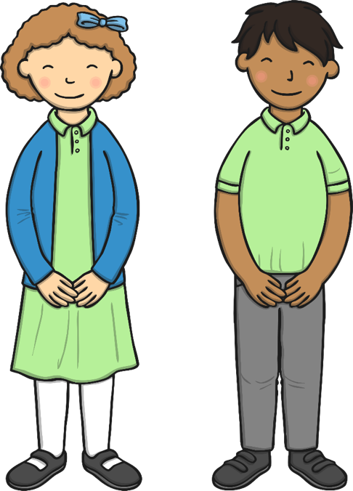
What are the main parts of our bodies?
What are the differences between girls and boys?

Slide 6
Reconnecting

Slide 7
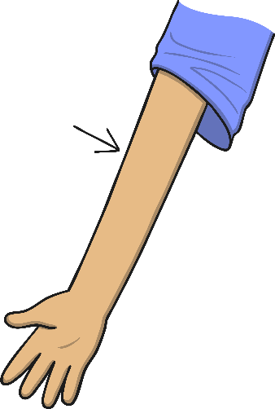
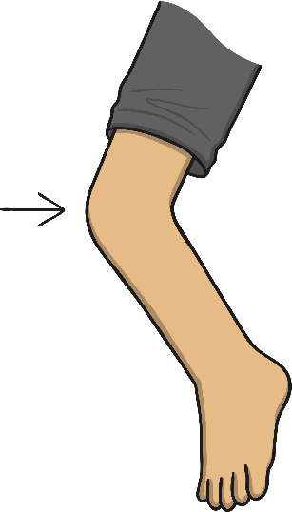
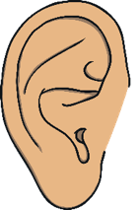
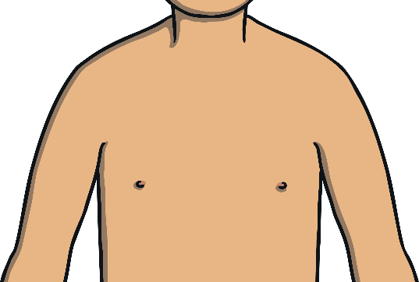
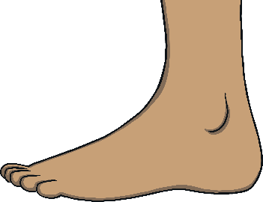
Our Bodies
Let’s play ‘Simon Says’!
When ‘Simon Says’ touch a part of your body, you should touch that part of your body. For example, ‘Simon says touch your nose’. So, touch your nose.
But if Simon doesn’t tell you what to touch, then you don’t touch it. For example, ‘touch your ear’. Because Simon didn’t tell you to, don’t touch your ear!

Slide 8
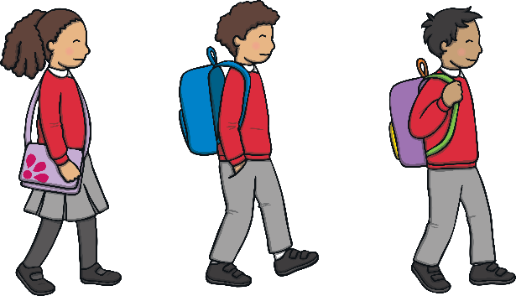
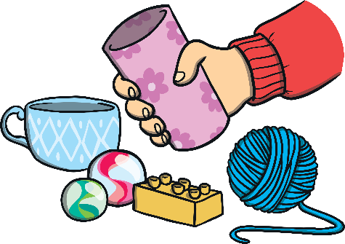
Our Bodies
From the moment we are born, our body parts are ready to grow and develop to help us do things.
Our legs learn to support us when we walk.
Our hands learn to hold and squeeze things.
Our eyes see, our noses smell and our ears listen.

Slide 9
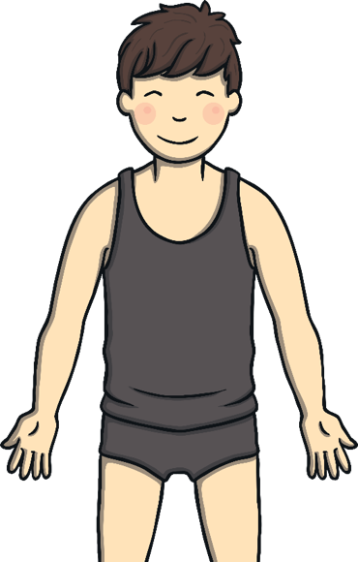
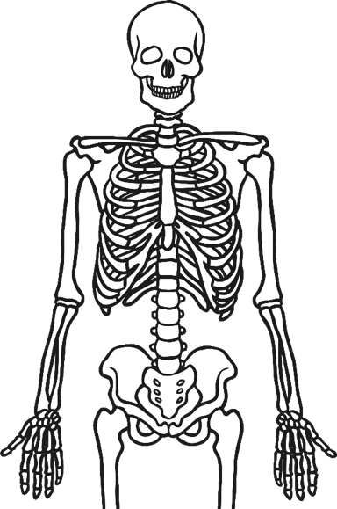
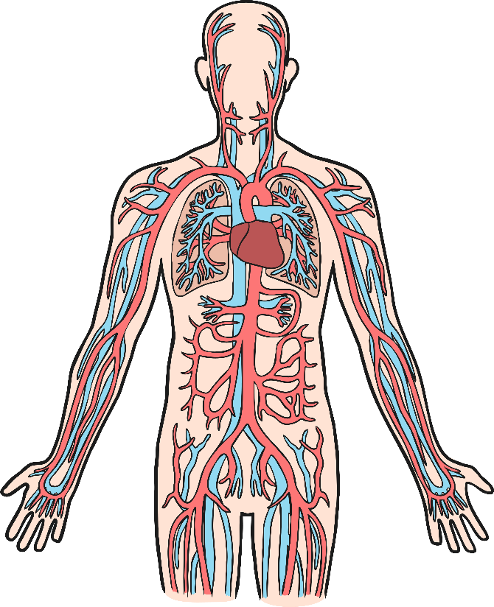
Our Bodies
Most of our body parts, inside and out, have special jobs to do.
Can you and your talk partner think of another body part and what it does?

Slide 10
Exploring

Slide 11
Girls and Boys
Are you a girl, or are you a boy?
How do you know?
Tell your partner all the things you can think of that make you a girl or a boy.

Slide 12
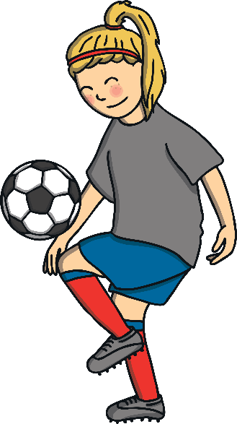
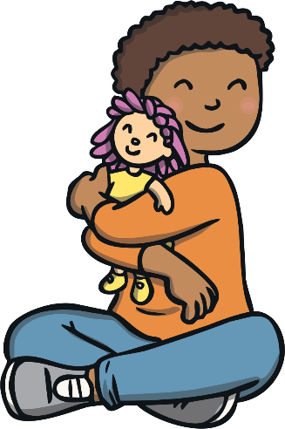
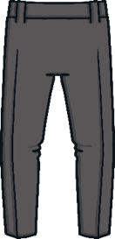
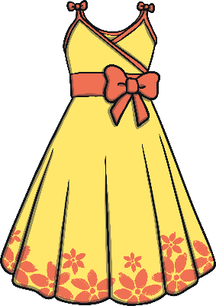
Girls and Boys
When talking to your partner, did you describe the things you like to do as a way of showing you are a girl or boy?
Did you tell your partner that your name is a girl’s or boy’s name?
Did you say that the way you look or the clothes you wear show whether you are a boy or a girl?

Slide 13
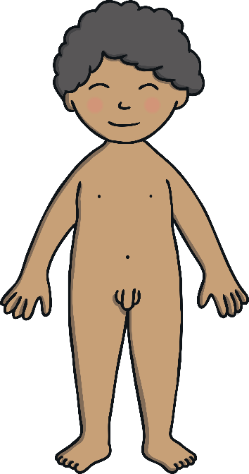
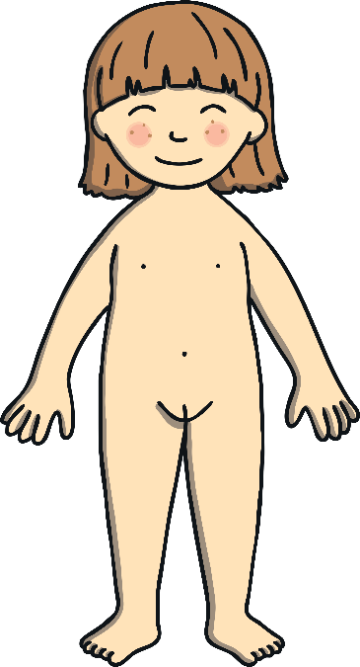
Girls and Boys
The way we look often lets others know if we are a boy or a girl and our names can be a clue, but not always. What about our bodies? Are they the same?
Such as arms, back, cheeks, shoulders, wrists, lips, toes, neck, nostrils and hips. The list is huge!
Girls and boys have lots of body parts that are the same and some that are different.
But there are some body parts that are different between girls and boys. Can you spot them on these pictures of babies?

Slide 14
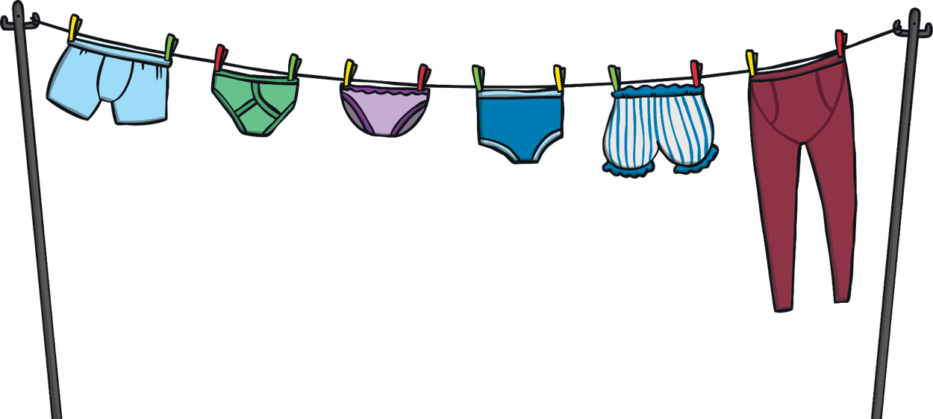
Girls and Boys
The differences between girls’ and boys’ bodies are hidden under our underwear.
You probably have a name for boys’ and girls’ private parts, but today we are going to use the scientific words – the words a doctor would use.
The scientific word for our private parts is genitals.

Slide 15
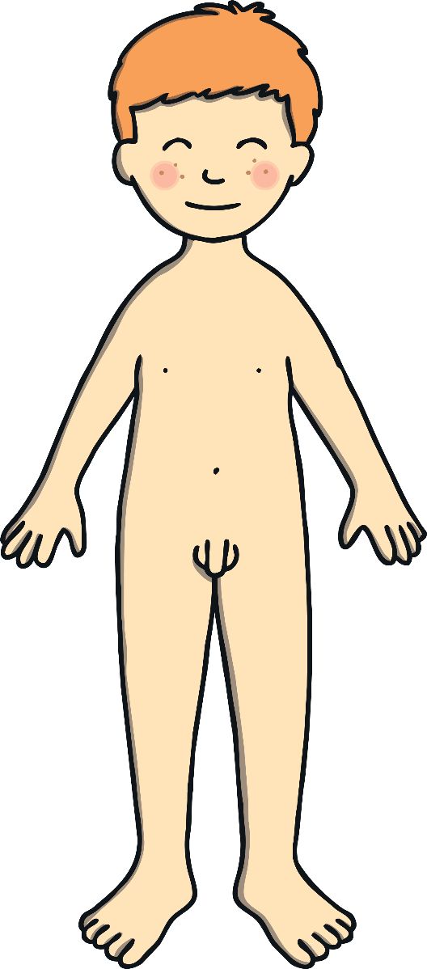
Boys’ Bodies
Boys have a body part called a penis.
People have other names they use for this part of the body, but the scientific word is penis.
Behind the penis are the testicles.
These body parts are only on males – that’s boys and men.

Slide 16
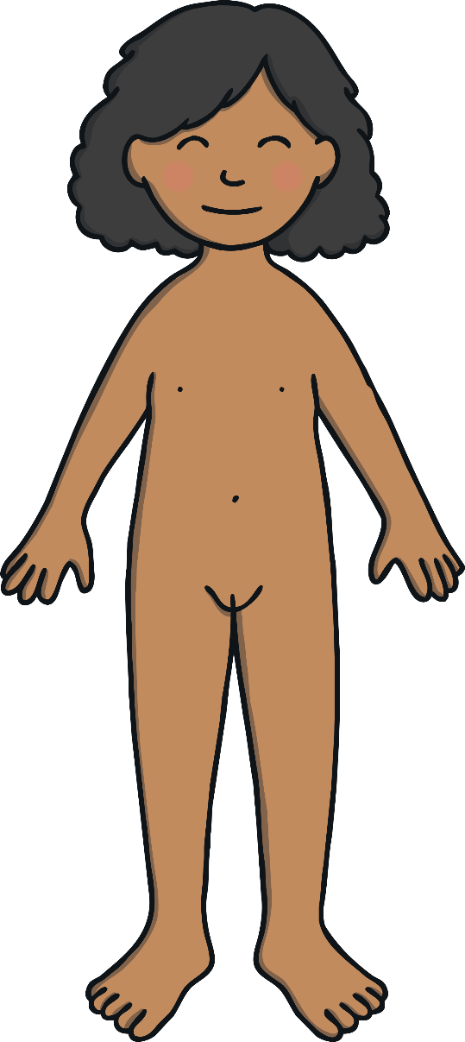
Girls’ Bodies
Females – that’s girls and women – don’t have a penis or testicles.
Girls have a vulva on the outside and a vagina, which is inside.
People have other names for these too, but vulva and vagina are the scientific words.

Slide 17
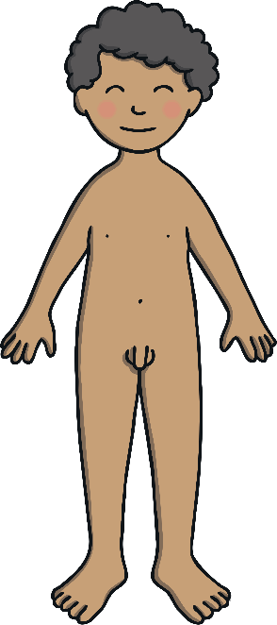
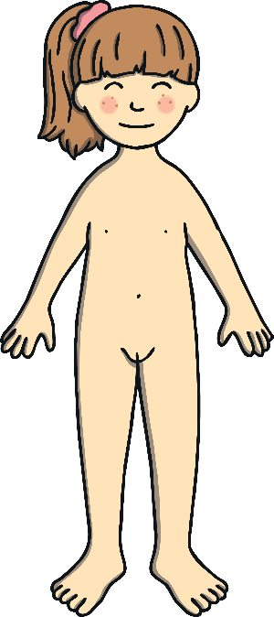
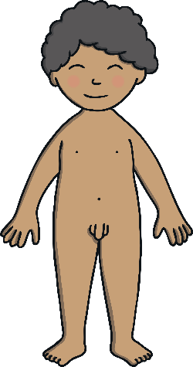
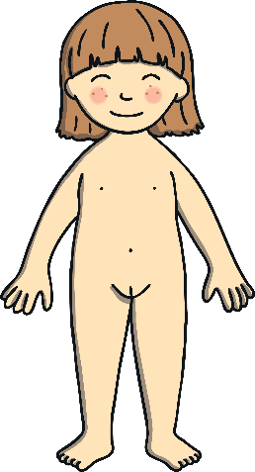
Private Parts
When we were babies, we didn’t think about doing things in private, or hiding our private parts.
Babies and toddlers don’t mind people seeing them in the bath and are sometimes naked at the beach, but they don’t feel embarrassed.
As we get older, sometimes we find that we like more privacy. We like to wear a swimming costume or swimming shorts at the pool or the beach. We like to go to the toilet in private and we might not want to take a bath with our brother or sister anymore.

Slide 18
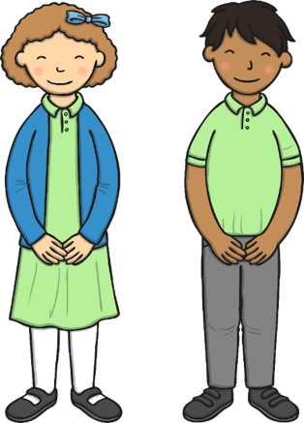
Consolidating
Reflecting

Slide 19
Consolidating

Slide 20
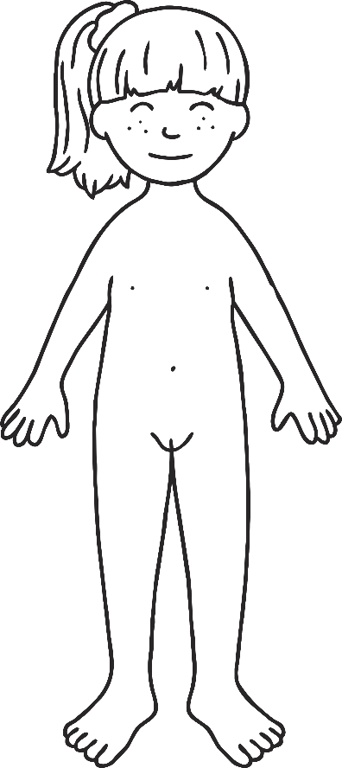
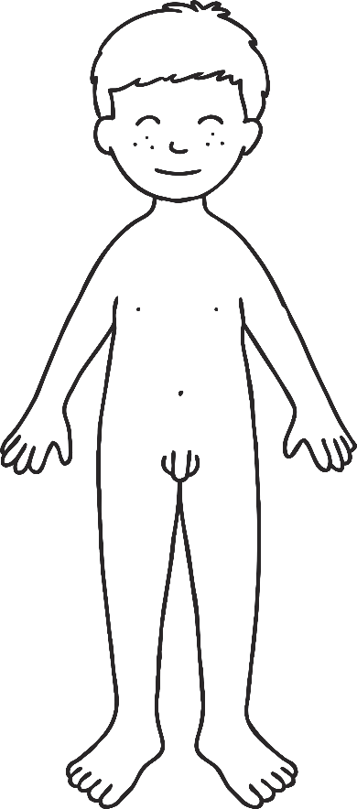
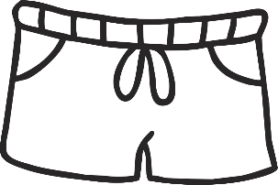
At the Pool
On the activity sheet there is a boy and a girl who want to get ready to go swimming. Label the body parts by writing the correct words in the boxes. Then, design their swimming costumes so they are ready for a swim at the pool.

Slide 21
Reflecting

Slide 22
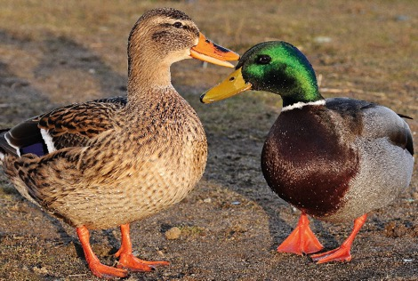
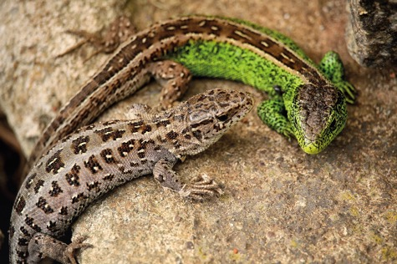
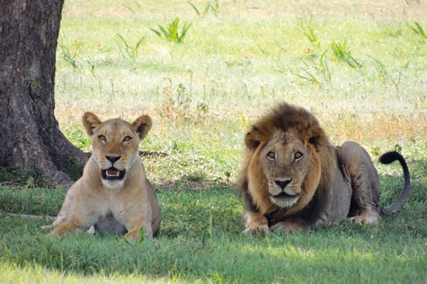
Males and Females
It isn’t just humans who have different male and female bodies. Look at these animals and spot the differences. Do you think there might also be differences we can’t see in the pictures?

Slide 23
The Big Questions

Slide 24
The Big Questions
What are the main parts of our bodies?
What are the differences between girls and boys?

Slide 25
Aim
I can name the main parts of boys’ and girls’ bodies.
Success Criteria
I can use the scientific names for parts of the body.
I can name the differences between girls’ and boys’ bodies.

