Slide 1
Reading at St stephen's

Slide 2
The
Importance of
Reading
All pupils should be encouraged to read widely across both fiction and non-fiction to:
Develop their knowledge of themselves and the world in which they live
Feed their imagination and curiosity
Gain knowledge across the curriculum
Learn new vocabulary
Establish an appreciation and love of different texts
Escape to other worlds

Slide 3
Our Aims Our Intent
To enthuse children as readers
Provide a rich reading culture
To create confident and competent readers, and in doing so, enable them to fully access the curriculum
To recognise that reading plays an important part of education and life

Slide 4
REading Programmes
Early Years ( Nursery/ Reception)
Talking about/ sharing and bringing alive texts
Oxford Reading Tree/ Phonics
KS1/ Yr 1:
Daily Supported Reading/ Phonics
KS1/ Yr 2:
Reduced DR/ DSR and Guided Reading Approach/ Phonics
KS2 (Yrs 3- 6) :
Destination Reader
KS2 (Yrs R- 6) :
Home Reader Books

Slide 5
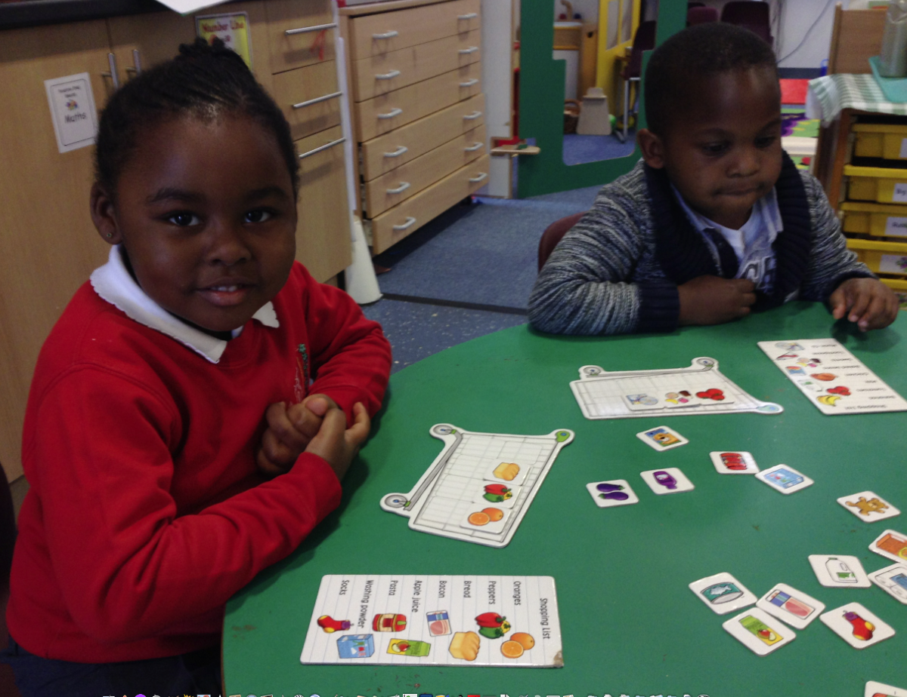
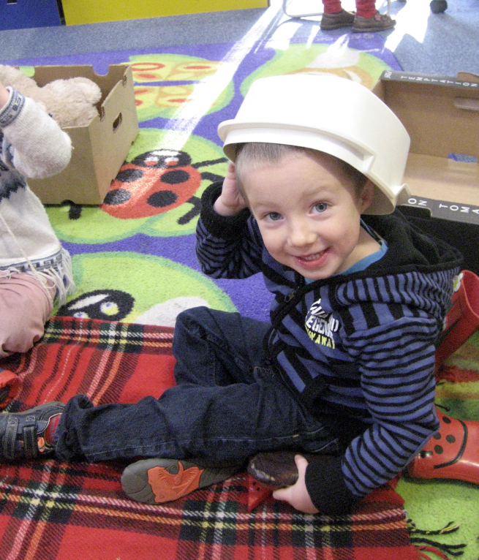
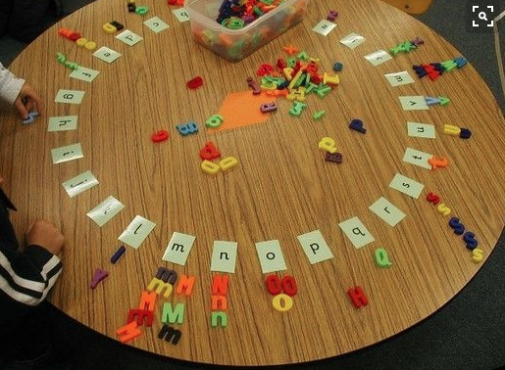
Early Years
Develop a passion for reading by bringing stories alive; talking; exposure to environmental print; quality texts
The Emergent Reader
Time is spent: teaching them how a book works; talking about texts; sharing texts; joining in repeated refrain, predicting ;re-telling with props; action; imaginative role play
Reading activities that are embedded in the nursery learning environment

Slide 6
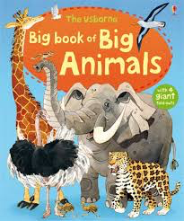
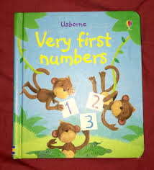
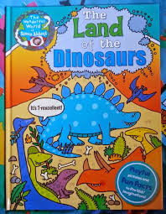
Early Years
Identifying what a word is
Exposure to repetitive texts/ rhyming
Initial letter prediction, phonic knowledge
Becoming an independent Reader
Developing Fluency
Sight vocabulary
Reduce reliance on decoding
Reading whole sentences etc

Slide 7
Early Years
Reading in Reception
Oxford Reading Tree
(supplemented by other texts)
Books organised in levels and linked to phonics
Regular 1:1 reading with adult
Initial letter prediction, phonic knowledge

Slide 8
Phonics at St Stephen’s
We follow ‘Letters and Sounds’
6 ‘phases’ from Nursery upwards
Letters and Sounds is delivered through multi-sensory, daily 20 minute sessions in Reception
We also use ‘Jolly Phonics’, using songs and actions to help children remember sounds.

Slide 9
Daily Supported REading
An approach to teaching reading which aims to:
Help children make accelerated progress by working in a coherent and systematic way. Children enjoy daily independent reading in small groups matched to their independent reading level, led by a trained adult.
Over the course of a week, children focus on the same book in a group setting:
Child has the book read to them
Child reads the book to a partner
Child reads the book to a trained adult
Child verbalises answers to comprehension questions which focus on retrieval, predicting skills
Child engages in sentence building and vocabulary activities to improve word recognition and phonological skills
Differentiated lesson guides are used to move children on and make sound judgements about when to do so.

Slide 10
rEading in Year 2
Phonics
Daily Supported Reading
Rich texts - guided reading
Destination Reader type sessions
Reading Baskets

Slide 11
What is Destination Reader?
An approach to teaching reading which aims to:
Foster a life-long love of reading
Develop a consistent approach to the teaching of reading across KS2
To guide teachers on best practice in teaching reading
To read for purpose across the curriculum
To have a consistent approach to developing vocabulary
To provide a robust assessment approach, centred on a formative assessment

Slide 12
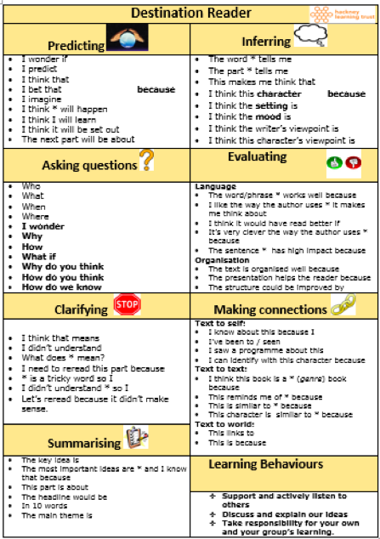
Strategies
Language Stems
Predicting
Asking Questions
Clarifying
Summarising
Inferring
Evaluating
Making Connections

Slide 13
Summative and Formative Assessments
EYFS
1:1 Reading regularly
KS1
Listening to them read 1:1 or in a group setting
Yr2 upwards Reading Assessment on a termly basis
KS2
Reading Albums: sets targets, monitors and review’s progress;
1:1 reading for targeted children
Termly reading assessment
Keeping Children on Track
With Their Reading
Enrichment Activities
• Book Fairs
• Trip to the library
World Book Day and other reading events
Reading Mornings in which parents are invited to read to with child/ class
Reading assemblies
Reading Challenges
Supporting those who are more challenged with their reading
KS1
Lexia Programme
Additional phonics support
Listening to child read on a more regular 1:1 basis
Screening programme which pinpoints areas for support

Slide 14
Supporting Your child
Read to and with your child
Actively listen to your child as they read
Make reading a regular activity in your home
Encourage your child to read a range of material - poetry, fiction, plays, biographies, non- fiction
Engage in discussion with your child about what they have read or has been read to them
Take them to the library or bookshop
Tell them stories; let them re-tell a story
Be a good role model - read alongside them

